Slide 1
Host phylogenetic distance drives trends in virulence and transmissibility across the animal-human interface
La distance phylogénétique de l'hôte détermine les tendances de virulence et de transmissibilité à travers l'interface animal-humain
Sarah Guth¹, Elisa Visher¹, Mike Boots^{1*}, and Cara E. Brook¹*
*Co-senior authors
¹University of California, Berkeley
Notes:
Virulence
Capacity for human-to-human transmission

Slide 2
The surge in emerging infectious diseases has inspired research to predict zoonoses (viruses that can emerge from animals to infect humans)
L'augmentation des maladies infectieuses émergentes a inspiré la recherche pour prédire les zoonoses (virus pouvant émerger des animaux pour infecter les humains)
Woolhouse and Gowtage-Sequeria 2005. Host range and emerging and reemerging pathogens. Emerging Infectious Diseases
Pulliam and Dushoff 2009. Ability to replicate in the cytoplasm predicts zoonotic transmission of livestock viruses. Journal of Infectious Diseases
Gomez et al. 2013. Centrality in primate-parasite networks reveals the potential for the transmission of emerging infectious diseases to humans. PNAS
Han et al. 2015. Rodent reservoirs of future zoonotic diseases. PNAS
Han et al. 2016. Undiscovered bat hosts of filoviruses. PLOS Neglected Tropical Diseases
Olival et al. 2017. Host and viral traits predict zoonotic spillover from mammal. Nature
Notes:
-increase in frequency of emerging infectious diseases
-majority are zoonotic
-define zoonotic
-in response: many studies have built databases/conducted meta-analyses to predict:
whether a particular animal pathogen could infect humans
or whether a particular animal has zoonotic viruses
-but BINARY: treats all zoonoses as equal risks

Slide 3
But not all zoonoses are created equal—some are larger threats than others
Mais toutes les zoonoses ne sont pas créées égales—certaines représentent des menaces plus importantes que d'autres

Slide 4
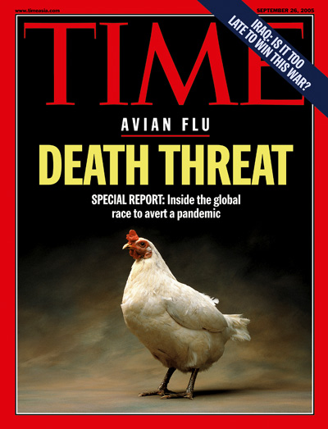
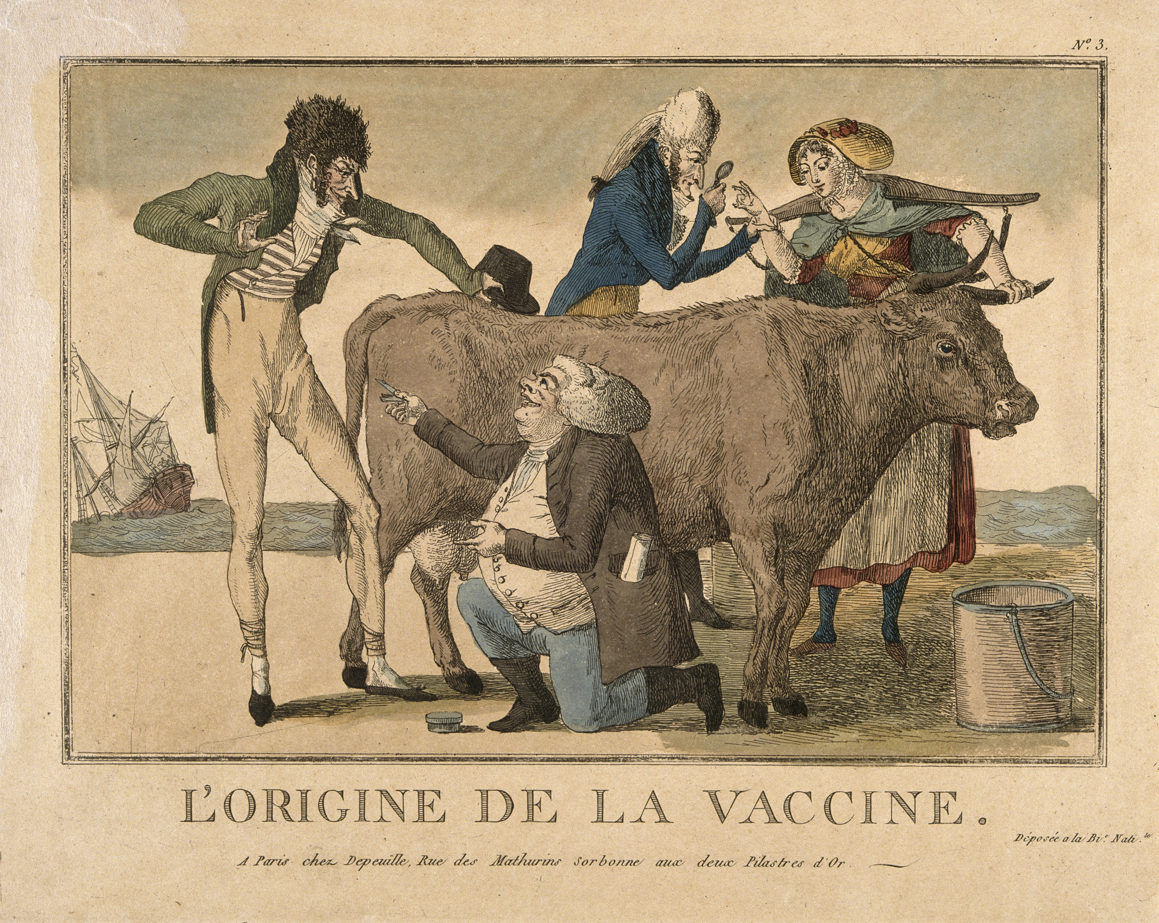
Variation in morbidity and mortality (‘virulence’)
Variation de la morbidité et de la mortalité (‘virulence’)
Notes:
Cowpox: poses such a low risk to humans that we once purposely exposed people to the virus as a vaccine for smallpox
Avian flu: much more significant threat, with human case fatality rates of up to 60%.

Slide 5
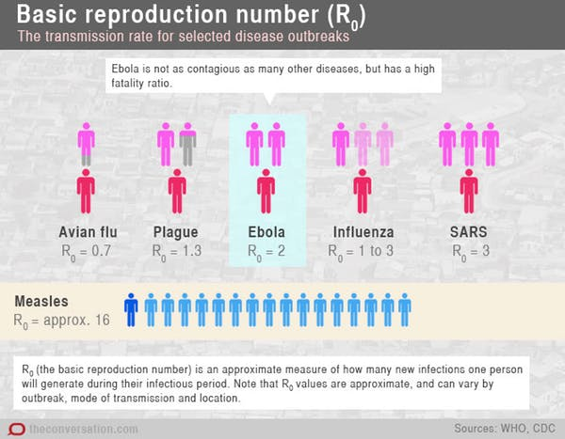
R₀ = number of secondary cases produced by a single infection in a completely susceptible population = nombre de cas secondaires produits par une seule infection dans une population complètement sensible
Notes:
-vary w/ respect for ability to transmit btw humans
-can measure this with: R0
-theoretical birth rate of pathogens
-determines the probability and SIZE of the epidemic
-considerable variation in a pathogens’ capacity for human-to-human transmission—not just transmissible vs. not transmissible—important to capture range because has implications for the probability of an epidemic AND epidemic size

Slide 6
Our analysis
Notre analyse
Goal = identify predictors of zoonotic risk
Objectif = identifier les prédicteurs du risque zoonotique
Focus = directly-transmitted viruses, mammalian hosts
Focus = virus directement transmis, mammifères hôtes
Compiled a database and applied generalized additive models (GAMs) to identify traits predictive of:
Human case fatality rates
Extent of human-to-human transmission following spillover
Compilé une base de données et appliqué des modèles additifs généralisés (GAM) pour identifier les traits prédictifs de:
Taux de létalité humaine
Étendue de la transmission interhumaine après le débordement
Notes:
-important to consider/understand variation in how diseases manifest– we’ll need diff intervention and control strategies
-goal = build off previous analyses, introduce more nuanced framework
-focused on directly-transmitted viruses (didn’t include vector-borne or reverse)

Slide 7
What animal traits best predict human case fatality rates and transmissibility of their zoonotic viruses?
Quels traits animaux prédisent le mieux les taux de mortalité humaine et la transmissibilité de leurs virus zoonotiques?

Slide 8
2) Directly-transmitted virus-mammal associations
1) Olival et al. 2017 virus-host database
3) Reservoir/spillover hosts
5) 94 unique zoonotic outcomes (grouped by host order) for spillover hosts
(66 unique viruses)
4) Collected:
-host predictors
-zoonotic risk metrics
Grouped case fatality rate and transmissibility by host order
Taux de mortalité et transmissibilité des cas groupés par ordre de l'hôte
Focused on directly-transmitted zoonoses from reservoir and spillover hosts
Centré sur les zoonoses directement transmises par les réservoirs et les retombées hôtes
6) Predicted human:
-case fatality rate
-transmissibility
Notes:
Started with previously published database
but focused on subset
-directly-transmitted—no vector-borne
-hosts defined as reservoir + evidence of direct spillover to humans
-grouped by host order (rabies example)

Slide 9
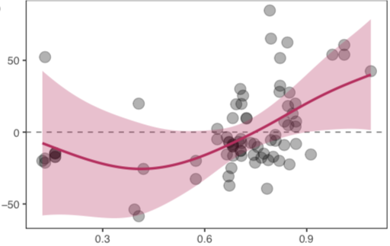
The most distantly related hosts harbor
the most virulent viruses Le port hôte le plus éloigné les virus les plus virulents
Effet sur le taux de létalité humaine
distance phylogénétique maximale de l'hôte par rapport aux humains
Notes:
1st GAM: response variable = case fatality rate
-partial effect plot of host phylo dist on human case fatality
-main trend = for distantly related, effect size line is above 0
Additional predictors:
Change in the urban to rural human population ratio
Overlap with crop and urban land
But the main trend here is that human case fatality rate increases with host phylogenetic distance from humans. So host species that are distantly related to humans, which we previously observed tend to have high zoonotic potential, are also associated with viruses that have high human case fatality rates.

Slide 10
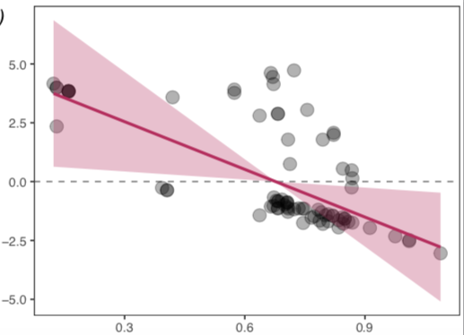
…but these virulent viruses in distant hosts are also the least transmissible between humans
… mais ces virus virulents chez des hôtes éloignés sont aussi les moins transmissibles entre humains
Effet sur la transmissibilité humaine
distance phylogénétique maximale de l'hôte par rapport aux humains
Notes:
2nd GAM: response variable = transmissibility
-partial effect plot
-here, we see the opposite trend
-distantly related hosts associated with viruses with reduced trans
Additional predictors:
Overlap with crop and urban land

Slide 11
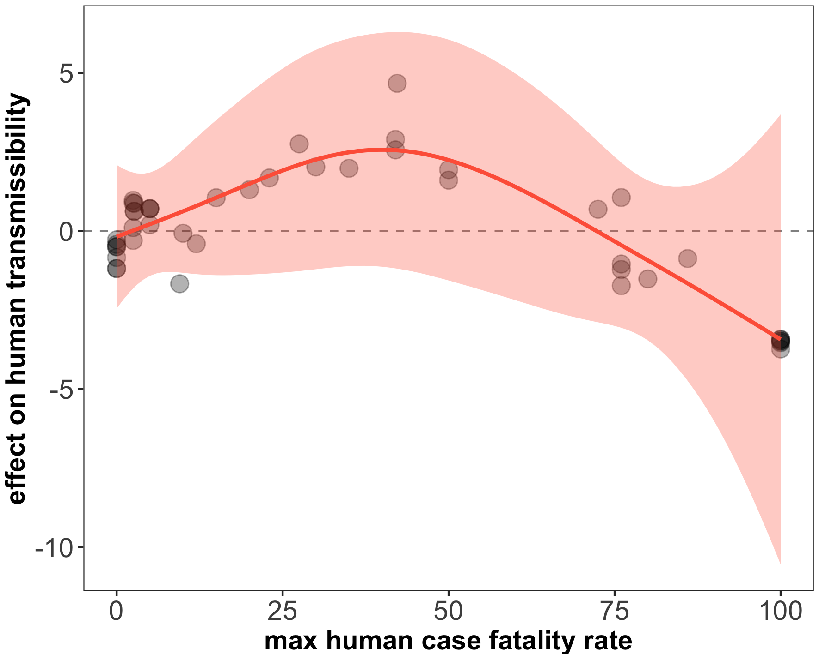
Following spillover, a relationship between virulence and transmission may constrain highly virulent viruses
Effet sur la transmissibilité humaine
Effet sur le taux de létalité humaine
Notes:
-appears to be this relationship, or tradeoff btw case fatality and trans
-ran separate GAM with CFR as predictor for trans to get a better look
-intermediate CFR have the strongest positive effect size on trans
-but highly virulent viruses associated with decreased trans
-maladaptive virulence – mortality shortens the infectious period, reduces opportunity for transmission
-phylo dist modulates relationship btw virulence and transmission – predicts case fatality and transmission “cost”
Additional predictors:
Overlap with cropland
Urban to rural human population ratio
Proportion of species that are artificial habitat users

Slide 12
Does the pathway of zoonotic emergence change the relationship between host phylogenetic distance from humans and zoonotic risk?
La voie d'émergence zoonotique modifie-t-elle la relation entre la distance phylogénétique de l'hôte par rapport aux humains et le risque zoonotique?

Slide 13
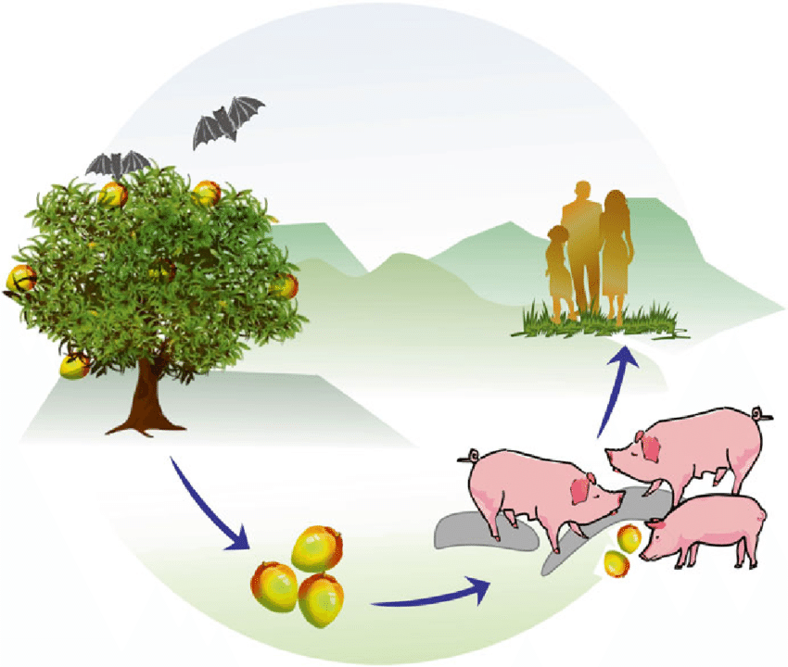
Nipah Virus
70% CFR
40% CFR
Notes:
-Bangladesh = direct = bats
-Malaysia = intermediate = pigs

Slide 14
Defining the spillover type for host order entries:
Direct = always spills over from reservoir hosts
Intermediate = always spills over from intermediate hosts
Both = spills over from both reservoir and intermediate hosts
Définition du type de débordement pour les entrées de commande hôte:
Direct = déborde toujours des réservoirs hôtes
Intermédiaire = déborde toujours d'hôtes intermédiaires
Les deux = débordements du réservoir et des hôtes intermédiaires
Notes:
-reran GAMs with interaction term btw spill type and phylo dist

Slide 15
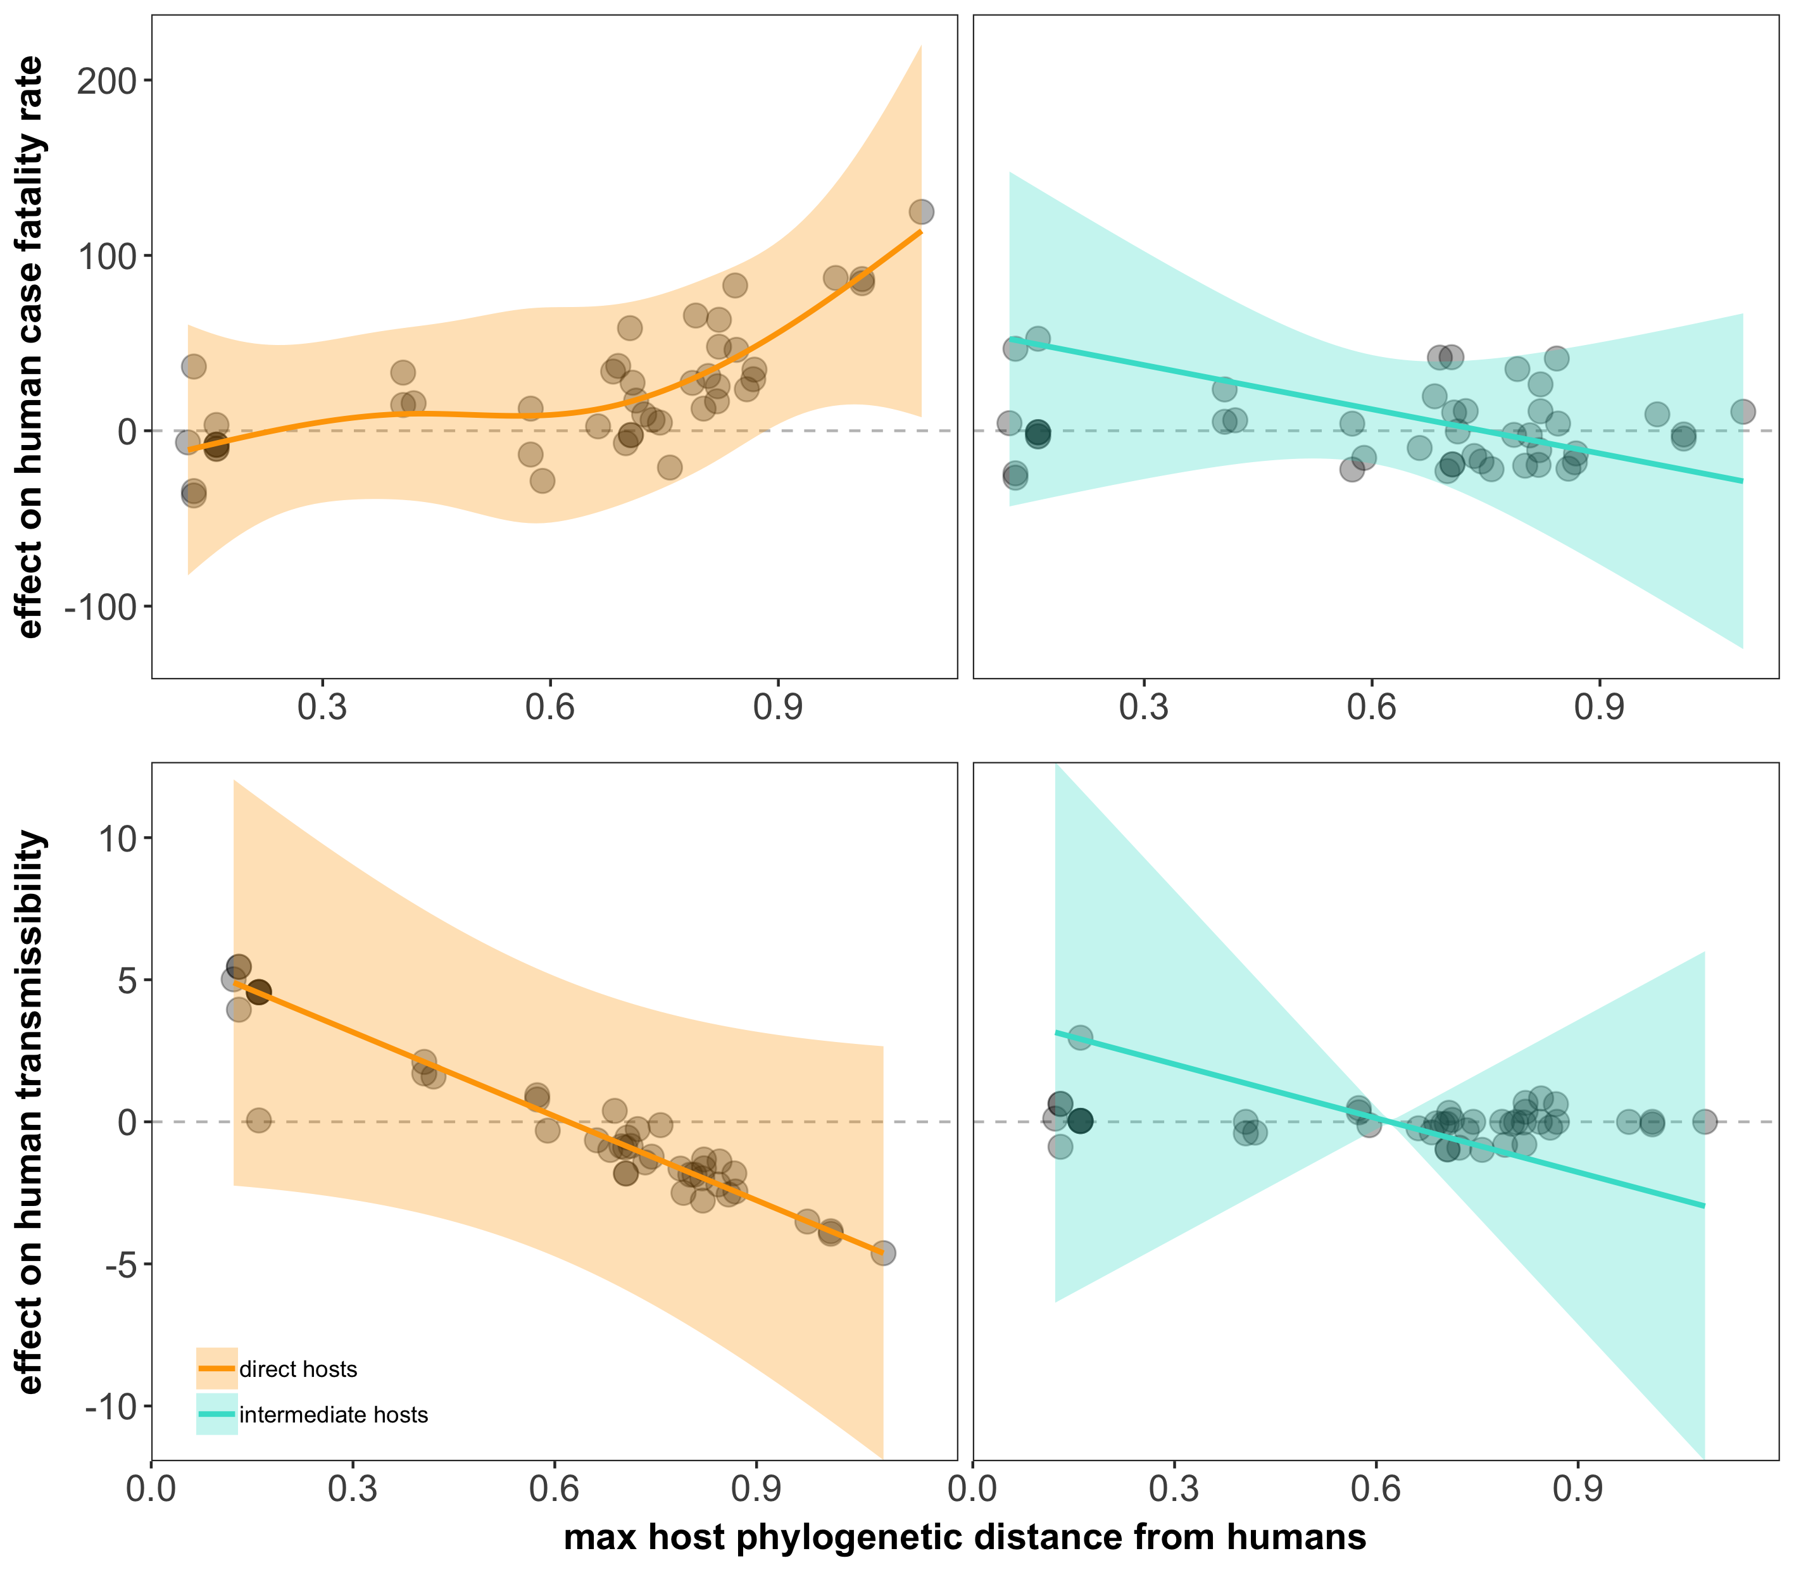
Direct spillover follows the same general trends, but intermediate spillover changes the relationship
Les retombées directes suivent les mêmes tendances générales, mais les retombées intermédiaires modifient la relation
Effet sur le taux de létalité humaine
Effet sur la transmissibilité humaine
distance phylogénétique maximale de l'hôte par rapport aux humains
Notes:
-spill type does modulate the relationship
-with direct spill, same general trends
-when there’s a positive effect on CFR, negative effect on trans
-but with intermediate spill, closely related hosts associated with BOTH higher CFR and trans
-doesn’t appear to be the same transmission “cost”
-”advantage” disappears as intermediate hosts become more distantly related
-arguable, intermediate hosts that are closely related = most ‘dangerous’
-virulence = long evo history with reservoir
-short-term history with intermediate – pre-adapt to trans btw humans
-intermediate hosts more likely to suffer severe disease – “best of both worlds”
-these results driven by diffs btw viruses
-only two examples
We also found that intermediate hosts are more likely to suffer severe disease than reservoir hosts – but we’re still analyzing the results for this section – so I don’t have any models to show you. But my guess is that having an intermediate host is giving viruses the “best of both worlds”. Infecting more susceptible intermediate hosts may allow these virulent viruses to have higher replication rates (which may be why we see more severe disease in these intermediate hosts) and would result in more virus in the human environment, increasing the probability of spillover. BUT at the same time, having an intermediate host that is more closely related to humans may allow these viruses to pre-adapt to human transmission. So they’re simultaneously maintaining their virulence, increasing the probability, while increasing their capacity for human-to-human transmission. But again, I’m not sure we can really tease apart this idea with our dataset – so it’s mostly speculative.
These results are driven mostly be differences we observed BETWEEN viruses that spill over directly vs. viruses that spill over through intermediate hosts. We only found two examples of viruses that have both direct and intermediate pathways of spillover, and different case fatality rates associated with those different spillover pathways. But both examples do appear to support our results.

Slide 16
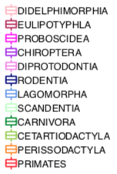
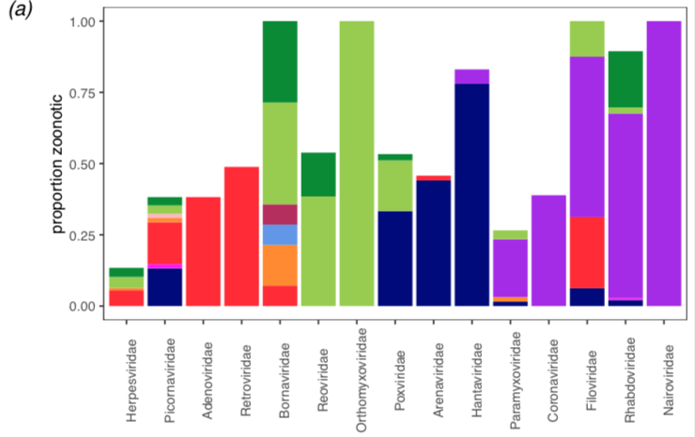
Host and virus types are correlated Les types d'hôte et de virus sont corrélés
Notes:
-host and virus types are correlated
-virus fam on x, prop of viruses in that fam that are zoonotic on y
-bars colored by which host orders that virus family infects
-bars for filo, rhabdo, and nairo are mostly purple - tend to infect chiroptera (or bats), have high zoo potential
-middle virus fams mostly blue, infect rodents
-so can see that a lot of these virus fams predictably infect particular host orders
-explored other side of equation – whether viral traits could predict zoonotic risk.
-also whether we’d see the same virulence-transmission relationship

Slide 17
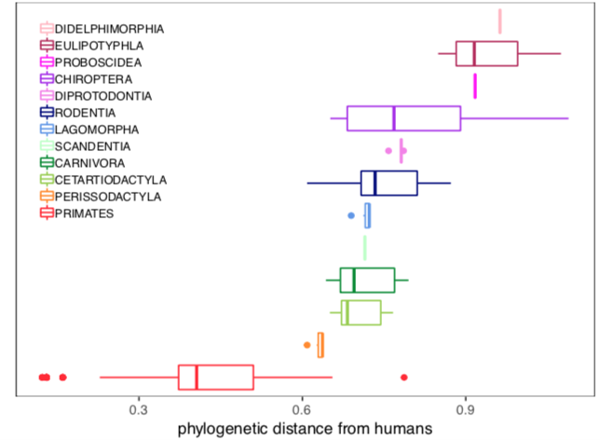
Notes:
-plot of host phylo dist grouped by host order
-host species cluster within predictable phylo ranges based on their phylo order
-particular host orders could be driving our trends btw phylo dist and zoonotic risk
-Chiroptera: distant from humans, extreme end of all of our trends

Slide 18
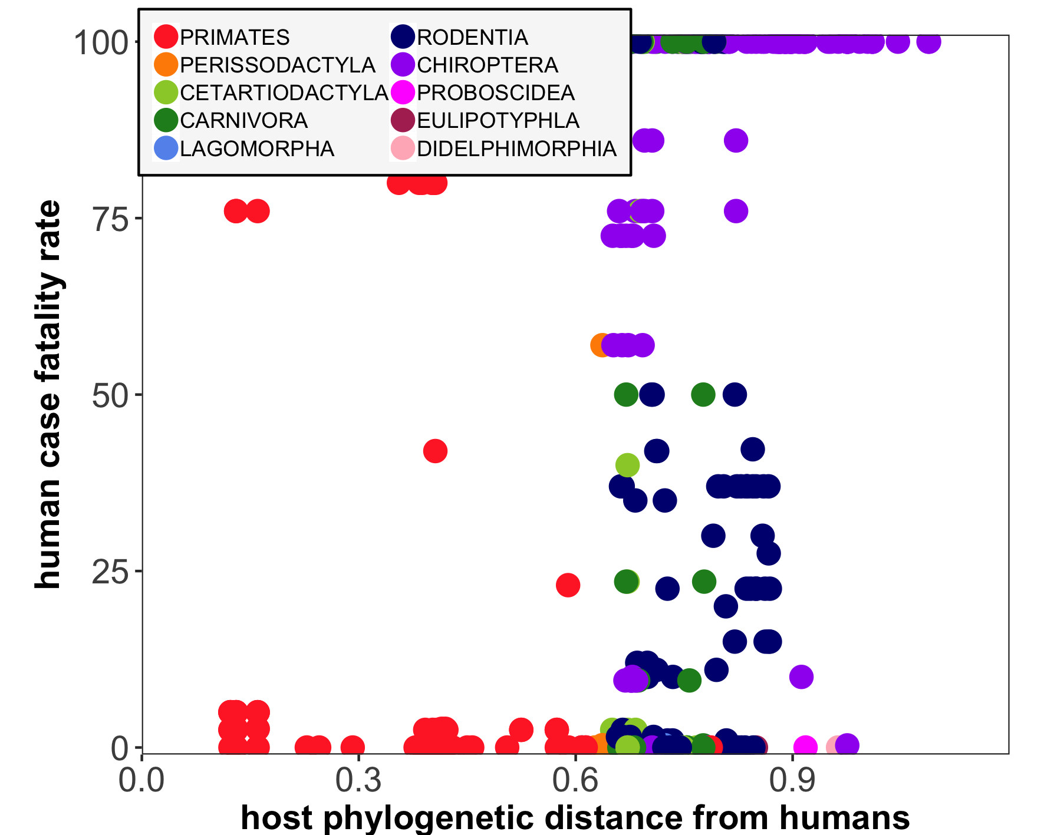
Bats as ‘special’
viral zoonotic reservoirs
Les chauves-souris comme ‘spéciales' réservoirs zoonotiques viraux
Notes:
-bats, still in purple, cluster in upper right – distant from humans, high CFR

Slide 19
Conclusion
Animals distantly related to humans host the most virulent viruses. Les animaux éloignés de l'homme hébergent les virus les plus virulents
But these virulent viruses in distant hosts are also the least transmissible. Mais ces virus virulents chez des hôtes éloignés sont aussi les moins transmissibles
Spillover from closely related intermediate hosts may be the most dangerous. Le débordement d'hôtes intermédiaires étroitement liés peut être le plus dangereux
Host order, virus type, and phylogenetic distance from humans are correlated. L'ordre de l'hôte, le type de virus et la distance phylogénétique des humains sont corrélés
Bats host the most virulent viruses. Les chauves-souris hébergent les virus les plus virulents
But data is limited. Mais les données sont limitées
Notes:
data is limited – Marburg vs. Nipah only examples of unique values; example of MERs (couldn’t include the bat association)

Slide 20
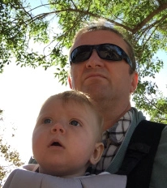


Thank you!
Merci!
Misaotra!
Elisa Visher
Mike Boots
Cara Brook
Notes:
----- Meeting Notes (3/7/19 15:23) -----
microbiome jumping between hosts...
diversity of viruses...
is diff from bats stochastic...
rabies outlier because bites

Slide 21
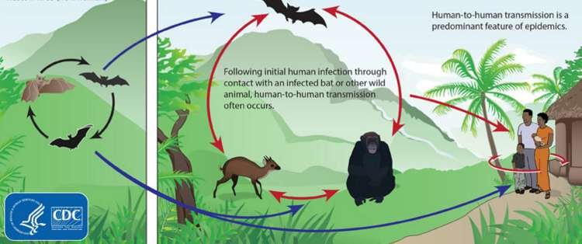
Marburg Virus
23% CFR
86% CFR
Notes:
-direct = bats
-intermediate = primates
-intermediate hosts may be reducing CFR, but still relatively high lvl of virulence
-our results would suggest that spill from int would be more trans, but we don’t have this data
-my guess is that there are diffs, and there are more examples like this
-Ebola example – multiple spill host, multiple outbreaks
-would be valuable to have more research on this

Slide 22
What viral traits best predict the
zoonotic potential of viruses?
Quels traits viraux prédisent le mieux potentiel zoonotique des virus?
Notes:
We first asked – what viral traits best predict the probability that a virus is zoonotic, or its’ zoonotic potential?

Slide 23
1) Olival et al. 2017 virus database
(586 viruses)
2) 338 directly-transmitted viruses
3) Collected
-viral predictors
-zoonotic status
Replicating analyses of zoonotic potential for directly-transmitted viruses
4) Predicted
-whether or not a virus is zoonotic
Notes:
-diff Olival database = 586 mammal-infecting viruses (zoonotic and non-zoo)
-extracted 338 directly-transmitted viruses
-their database came with most of our viral predictors
-collected some additional traits like taxonomy, genome composition, recombination rate from other sources
-ran our GAM with binary response variable – either virus is or is not zoonotic

Slide 24
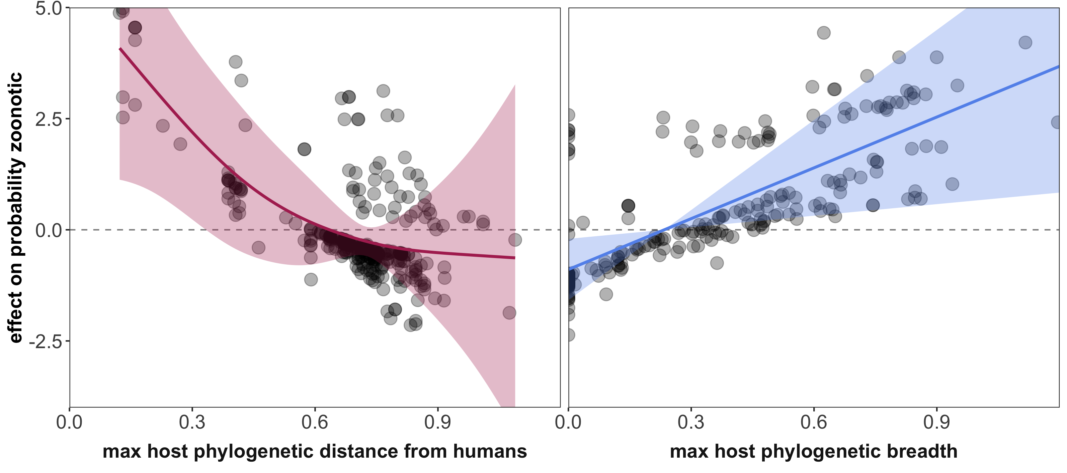
Host breadth matters, but so does the distance of that range La largeur de l'hôte est importante, mais la distance de cette plage aussi
Notes:
-considered 2 viral traits related to the TYPE of hosts a virus infects:
1)Phylo dist for a virus’ most distantly related host (max phylo dist for that viruses’ set of host species)
-has not been included in previous analyses
2)How different are the hosts in that set - phylo range (breadth)
-has been included
-like Olival, host breadth = sig predictor – generalists more likely zoonotic than specialists
-but found that phylo dist was also sig predictor
-host breadth is important, but so is the position of that breadth
-don’t see U-shape relationship – included both dist and breadth in model
-effect of phylo dist on prob zoonotic while accounting for effect of breadth

Slide 25
What viral traits best predict
human case fatality rates and transmissibility of zoonotic viruses?
Quels traits viraux prédisent le mieux taux de létalité humaine et transmissibilité des virus zoonotiques?
Notes:
The keeping in line with our host model methods, we asked what viral traits best predict our two additional zoonotic metrics – human case fatality rate and capacity for human-to-human transmission?

Slide 26
1) Olival et al. 2017 virus database
(586 viruses)
3) Collected
-viral predictors
-zoonotic risk metrics
2) 338 directly-transmitted viruses
5) Predicted human:
-case fatality rate
-transmissibility
4) 68 unique zoonotic outcomes
(66 unique viruses)
Notes:
-now interested in only zoonoses
-unique CFR and trans for each virus
-66 zoonotic viruses, but 2 entries for Nipah and Marburg
-GAMs with CFR and trans as response variables

Slide 27
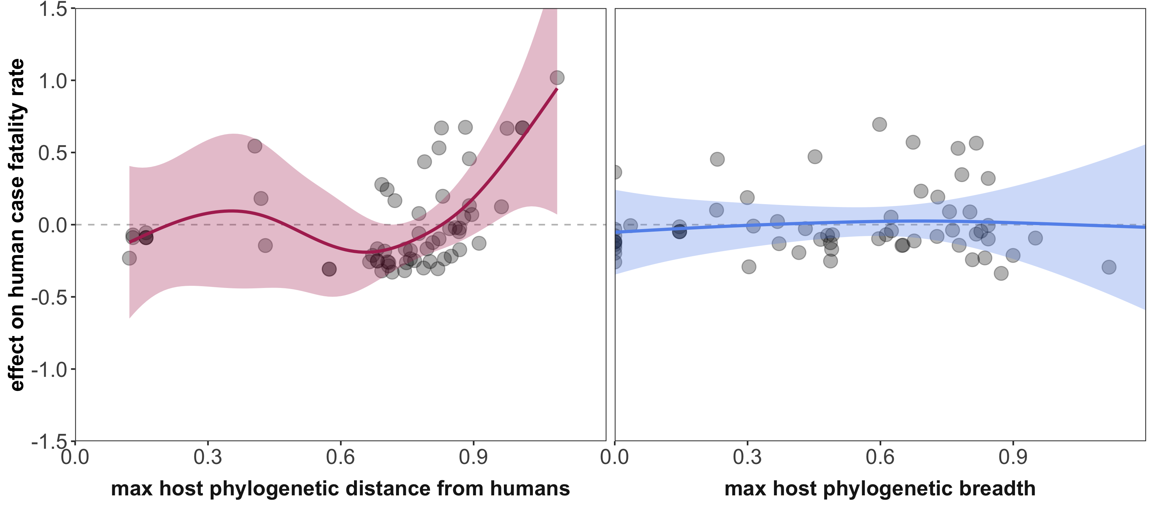
Infecting hosts that are distantly related from humans is associated with virulence Infecter des hôtes éloignés de l'homme est associé à la virulence
Notes:
-partial effect plots for phylo dist and breadth
-host models – case fatality increased with host phylo dist
-same trend – viruses that infect more distantly-related hosts associated with higher CFR
-breadth did not have sig effect

Slide 28
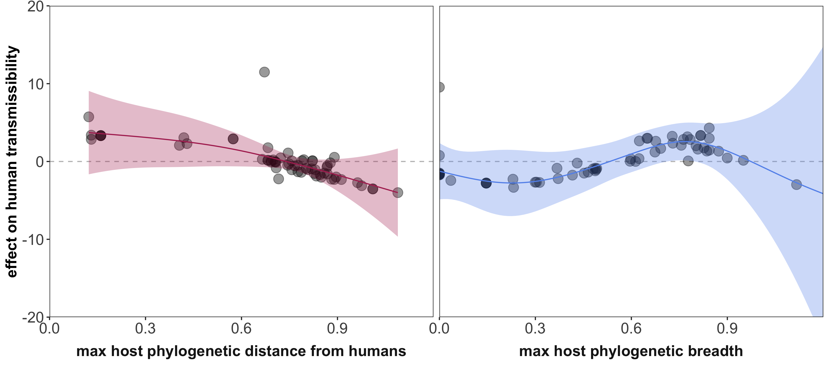
…but these virulent viruses in distant hosts are also the least transmissible between humans
… mais ces virus virulents chez des hôtes éloignés sont aussi les moins transmissibles entre humains
Notes:
-partial effect plots for phylo dist and breadth from our best fit model for viruses’ capacity to transmit btw people
-host models – trans decreased with phylo dist
-same trend – viruses that infect more distant hosts are more virulent, but less transmissible btw people
-breadth more complicated
-viral traits can predict zoonotic risk, same virulence-transmission relationship
-predictors of zoonosis differ from predictors of virulence and transmissibility
-zoonosis: genome comp and replication in the cytoplasm
-virulence/transmissibility: whether or not virus enveloped
-highlights importance of considering both
Our model for transmissibility had the same set of predictors as our model for case fatality. But these predictors differ from the predictors we had for probability a virus is zoonotic – in our first zoonotic potential model. We swapped genome composition and replication in the cytoplasm for whether or not a virus is enveloped. It’s interesting that the predictors of zoonosis differ from predictors of how viruses will manifest in the human population. And this really just highlights the importance of considering both – just predicting whether a virus is zoonotic isn’t going to tell you what the burden of the virus will be once it has spilled over into the human population
In line with the virulence-transmission relationship that we saw in our host models,
these more virulent viruses that infect hosts that are distantly related to humans are the least transmissible between
So we did find here that viral traits can also predict our metrics of zoonotic risk
And we see the same virulence-transmission relationship underlying our results, with host phylogeny modulating that relationships

